Slide 1
Responsible Behavior for the Elementary Student
March 9, 2013
No Why Kids - of All Ages - Need to Hear It and Ways Parents Can Say It by David Walsh, PhD
www.GoodCharacter.com

Slide 2
When you agree to do something, do it. If you let people down, they'll stop believing you. When you follow through on your commitments, people take you seriously.

Slide 3
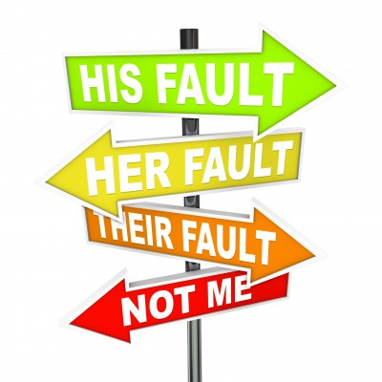
Answer for your own actions. Don't make excuses or blame others for what you do. When you take responsibility for your actions you are saying "I am the one who's in charge of my life."

Slide 4
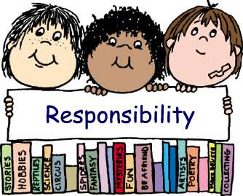
Take care of your own matters. Don't rely on adults to remind you when you're supposed to be somewhere or what you're supposed to bring. You take the responsibility.

Slide 5
Be trustworthy. If somebody trusts you to borrow or take care of something, take care of it. If somebody tells you something in confidence, keep it to yourself. It's important for people to know they can count on you.

Slide 6
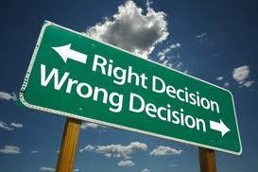
Always use your head. Think things through and use good judgment. When you use your head you make better choices. That shows your parents they can trust you.

Slide 7
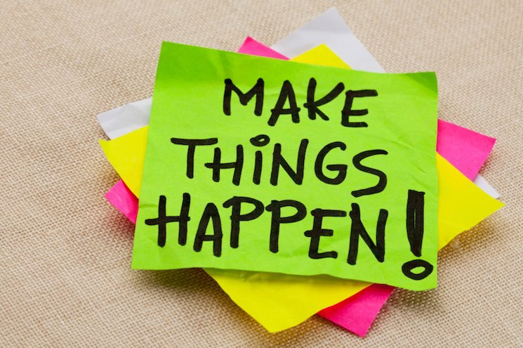
Don't put things off. When you have a job to do, do it. Doing things on time helps you take control of your life and shows that you can manage your own affairs.

Slide 8
Think, Pair, Share
Turn and Talk to your shoulder partner and discuss the following questions:
What does it mean when someone is described as a "responsible" person?
What are some of the responsibilities kids your age have?
Are there some reasons why you might want to be considered a "responsible" person?

Slide 9
Quiz Time
On your whiteboard take the following quiz:
How responsible are you?
For each of the six responsible behaviors outlined in the PowerPoint that you just watched, rate yourself on a scale of one to five (1=not so great, and 5=terrific). For each of these behaviors give an example of how you are either responsible or irresponsible, and what you could do to improve.

