Slide 1
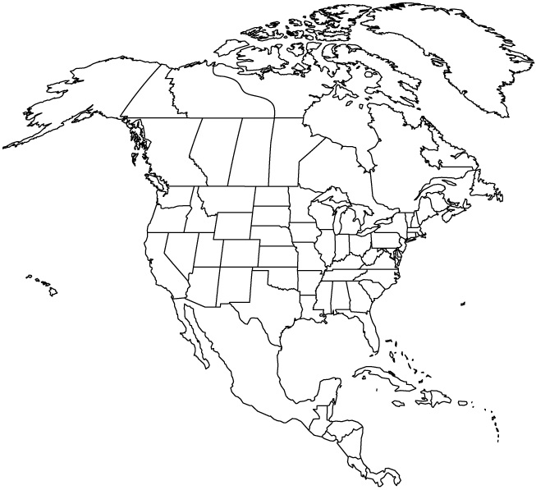
Explorers of North America

Slide 2
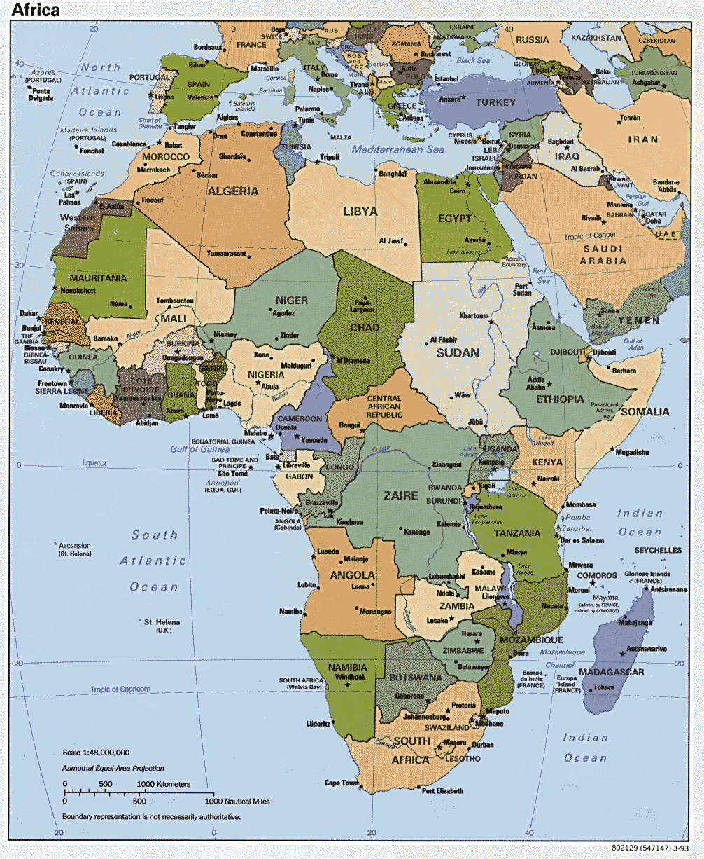
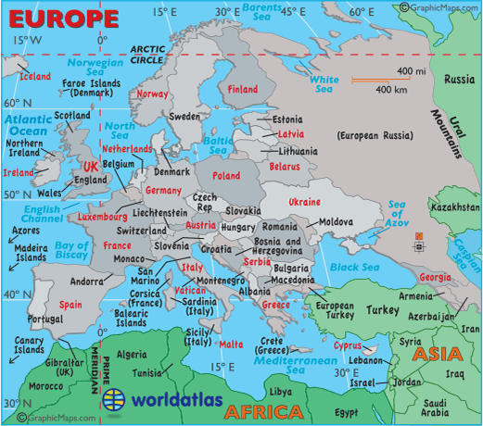
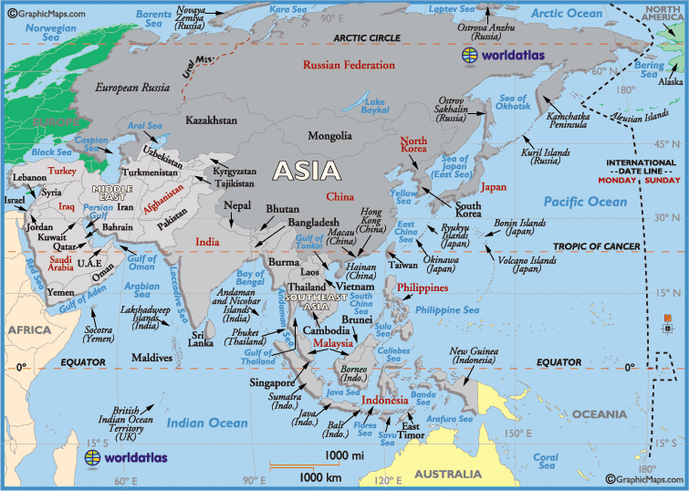
In the 1400’s most Europeans knew little about the world outside of their own villages.
Educated people knew of 3 continents:
Europe
Africa
Asia
They also knew there were new lands to be discovered across the oceans.

Slide 3
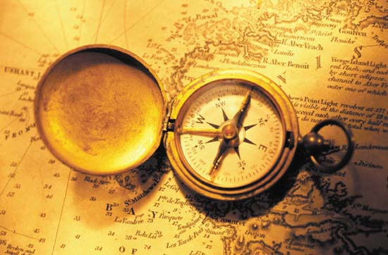
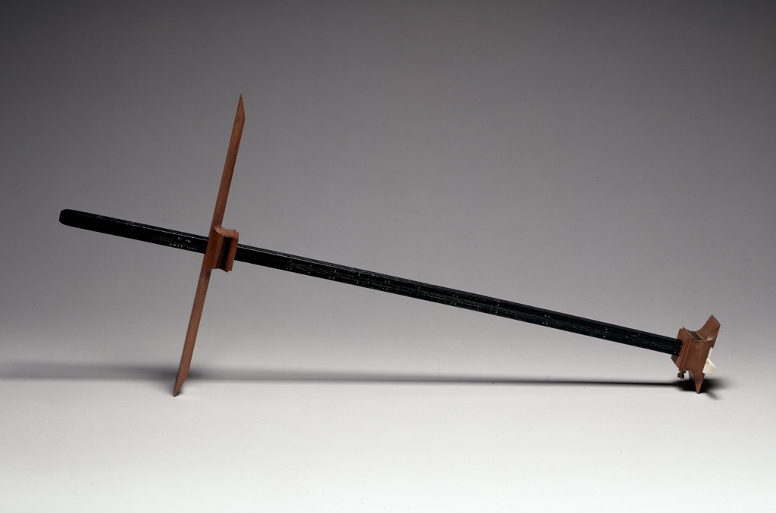
Navigational Tools
Magnetic compass
Cross staff
Measured the distance between the horizon and the north star
Used to find latitude

Slide 4
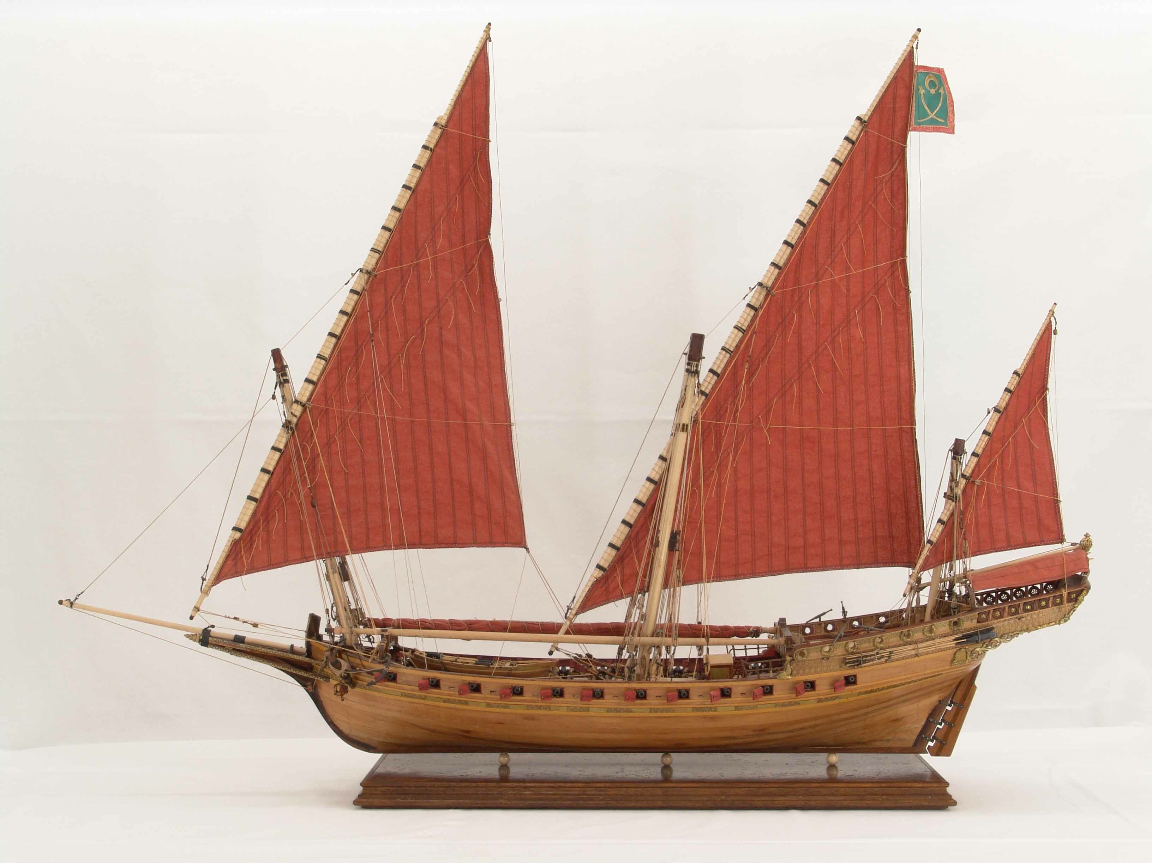
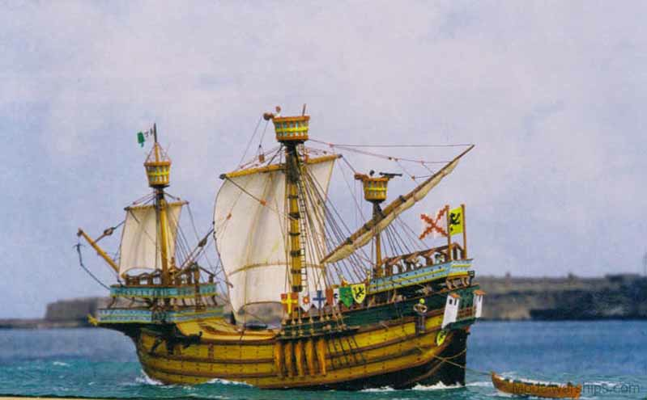
Arab Ship
Europeans had learned about an Arab ship called the caravel.
The ship had a rudder for steering and triangular sails, which let the ship sail in any direction. Portuguese shipbuilders borrowed ideas from the caravel and created a larger, stronger ship called a carrack.
-caravel
-carrack

Slide 5
Reasons for Exploring New Lands
The Europeans wanted to explore new lands to:
Spread their faith
Expands their countries
Owning new lands
Trade
Fine silks, spices, and perfumes from eastern Asia

Slide 6
Explorers of Asia- “The Indies”
The Europeans decided to explore Asia- “The Indies” because they wanted to buy their goods at cheaper prices than then were paying.
Marco Polo, Prince Henry and Bartolomeu Dias all set out to explore the Indies but not every explorer made it.

Slide 7
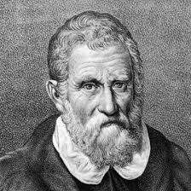
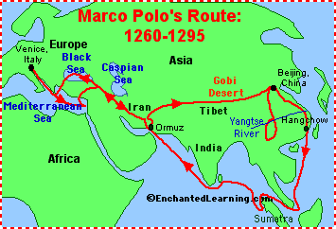
Marco Polo
Italian merchant (trader)
In 1271 Polo traveled east by land and reached the Indies 4 years later

Slide 8
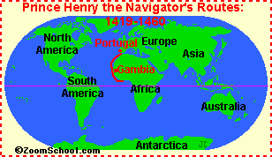
Prince Henry
From Portugal
In the 1400s Henry figured out that ships could sail east to reach the Indies.
Paid sailing crews to find the route, but his men didn't’t get farter then the western coast of Africa.

Slide 9
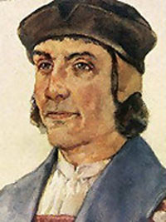
Bartolomeu Dias
From Portugal
Sailed around the tip of Africa but never made it to the Indies

Slide 10
Review!
What were some of the tools used by the Europeans to explore?
Who tried to sail to the “Indies”?
Who made it to the “Indies”?

Slide 11
Answers
What were some of the tools used by the Europeans to explore?
Magnetic compass
Cross staff
Who tried to sail to the “Indies”?
Marco Polo
Prince Henry
Bartolomeu Dias
Who made it to the “Indies”?
Marco Polo

